Slide 1
North Korean Refugee Flows: Existing knowledge, Trends from other cases, Lessons to Learn
Sandra Fahy, Ph.D.
Post-Doctoral Fellow, Korean Studies Institute, University of Southern California
smfahy@gmail.com

Slide 2
Structure of the Talk
What existing knowledge do we have about North Korean refugee/ migration flows?
What patterns are typical in other cases of refugee/ migration flows?
What can this teach us about best policy for North Korea?

Slide 3
Our Existing Knowledge on North Korean refugee/ migration:
Famine marked the beginning of North Korean out-migration (Early-Mid 1990s)
Numbers of North Koreans setting in ROK grew remarkably in the last decade.
Estimates of between 20,000 -300,000 North Koreans in China.
North Koreans have settled in other countries too.

Slide 4
Noteworthy Characteristics
North Korean refugee/ migrants tend to be in their 20s and 30s.
This reflects the physical strength necessary to make the journey, more future-oriented mindset and increase in defection of women of marriageable age.

Slide 5
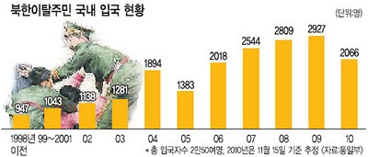
Arrival of North Koreans by Year

Slide 6
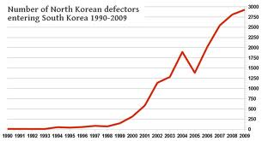
Total Numbers Across Time in ROK

Slide 7
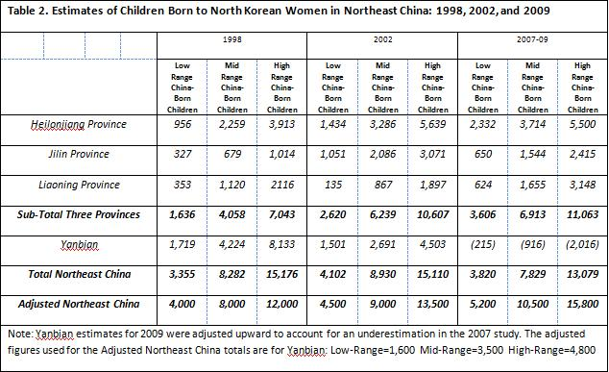
North Koreans in China

Slide 8
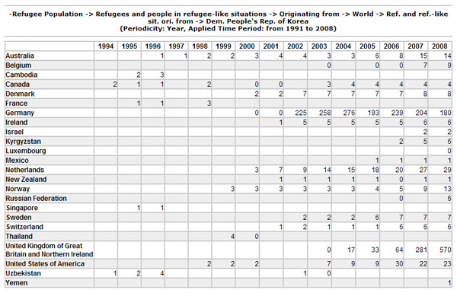
North Koreans in the World

Slide 9
Regional Fears about Refugee Foods
Many scholars, think-tanks, government workers and others are beginning to talk about “floods of North Koreans” in the case of major changes in North Korea.

Slide 10
Predictions
Ku Seop Kim
Head of North Korean Research of KIDA at that time and former President of KIDA(2008-2011)
at least 4 million or almost North Korean people
www.chosun.com 01/29/1995
Sung Ho Ahn
Professor of Political Science in Chung Buk National University
4 million
a conference of 60th anniversary of National Foundation in National Assembly
Nam Sung Hur
emeritus professor of Korea National Defense University. This university is only for current soldiers.
maximum 4 million
an inaugural conference of National contingency of National Assembly
Yong Won Yoo
A military report of Chosun Ilbo. He is known as the best military report of South Korea
Over 2 million
www.chosun.com 09/22/2008

Slide 11
Predictions
Sung Wook Nam
President of the Institute for National Security Strategy (a think tank of NIS of South Korea)
"three hundred thousand in two months
(reason: when the Berlin Wall was removed, 1.8 hundred thousand East Germany people defected to West Germany in two months)"
www.chosun.com 09/26/2008
In ae Hyun
President of North Korea Intellectuals Solidarity
mass defection is not going to happen
an inaugural conference of NK Intellectuals Solidarity
Yun Young Kim
Senior Research Fellow of Police Science Institute
from 2 million to 4 million by regime change or collapse, from 11 hundred thousand to 1.8 million by the process of the contingency
the police science institute review no.11 June 2009
Ministry of National Defence
one hundred thousand if the North can control, from 1.8 million to 2 million if the North cannot control
www.segye.com 10/13/2010

Slide 12
What about other cases?
“Mass Migration” is defined as anything over 10,000
Caused by several factors
Gov’t failure to protect minority population
Gov’t under attack by armed groups seeking power
Conflicts in war with colonial power
Gov’t involved in the persecution of citizens
Migration to deal with drought, flood, famine, etc.

Slide 13
Other Cases:
In 1969, the majority of refugees worldwide resembled the North Korean refugee case…
= People fled authoritarian regimes after their collapse because they were able to do so
and they had somewhere to go.
Nowadays, global trends in refugees: results from inter-state wars and ethnic conflicts.

Slide 14
Lessons to Learn?
North Korean refugee floods: Where will they go? DMZ, Sino-Korea border?
Even if maximum predictions are correct: the vast majority of North Koreans will remain in the North.

Slide 15
The Internally Displaced
During Korean War – 2.9 Mill. IDPs
Culture played role
Geography
Loyalty to family and territory
Fear of foreign countries
Similar factors will keep North Koreans displaced / migrating within the North.

Slide 16
Lessons to Learn:
Migrating people typically plan to move temporarily, nurturing the wish to return home.
May be economic, political, health disincentives to returning.
Greatest number of migrations will be internal to the DPRK.

Slide 17
Recommendations
To assist in refugee flows:
Pressure China and third countries to accept North Koreans as refugees, not return them to the North, and pressure other countries to accept North Koreans.
Use the existing network of North Korean settlers in the ROK and beyond to bring family members safely out.

Slide 18
Recommendations
To assist return migration to North Korea:
Facilitate financial remittances to North Korea via family members and third parties
Work with government, NGOs etc to prepare for the inevitable issues of health, loose-weapons, abandoned children etc., involved with internally displaced people inside North Korea.

